Slide 1
Arrays in C
By: Nida munawar

Slide 2
Arrays
Name of array (Note that all elements of this array have the same name, c)
An array is a collection of variables of
a certain type, placed contiguously in
memory.
Array
Group of consecutive memory locations
Same name and type
To refer to an element, specify
Array name
Position number
Format:
arrayname[ position number ]
First element at position 0
n element array named c:
c[ 0 ], c[ 1 ]...c[ n – 1 ]
c[0]
-45
c[1]
6
c[2]
0
c[3]
72
c[4]
1543
c[5]
-89
c[6]
0
c[7]
62
c[8]
-3
c[9]
1
c[10]
6453
c[11]
78
Position number of the element within array c

Slide 3
Arrays (Cont’d)
Array elements are like normal variables
c[ 0 ] = 3;
printf( "%d", c[ 0 ] );
Perform operations in subscript. If x equals 3
c[ 5 - 2 ] == c[ 3 ] == c[ x ]
When defining arrays, specify
Name
Type of array
Number of elements
arrayType arrayName[ numberOfElements ];
Examples:
int c[ 10 ];
float myArray[ 3284 ];
Defining multiple arrays of same type
Format similar to regular variables
Example:
int b[ 100 ], x[ 27 ];

Slide 4
Arrays (Cont’d)
Initializers
int n[ 5 ] = { 1, 2, 3, 4, 5 };
If not enough initializers, rightmost elements become 0
int n[ 5 ] = { 0 } ;
All elements 0
If size omitted, initializers determine it
int n[ ] = { 1, 2, 3, 4, 5 };
5 initializers, therefore 5 element array

Slide 5
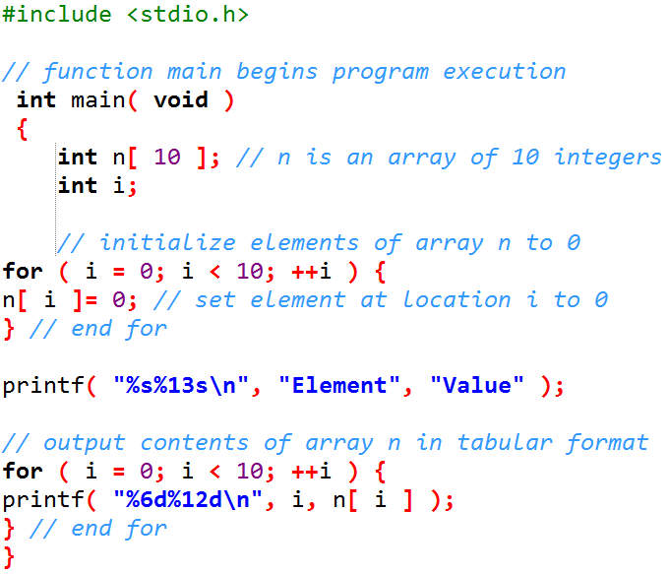
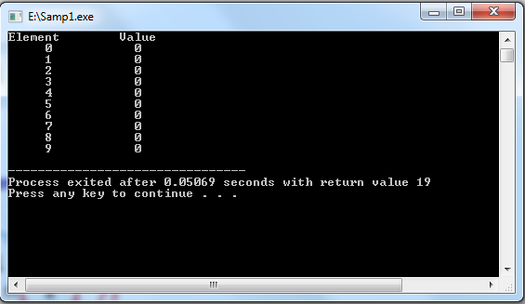
Arrays (Cont’d)

Slide 6
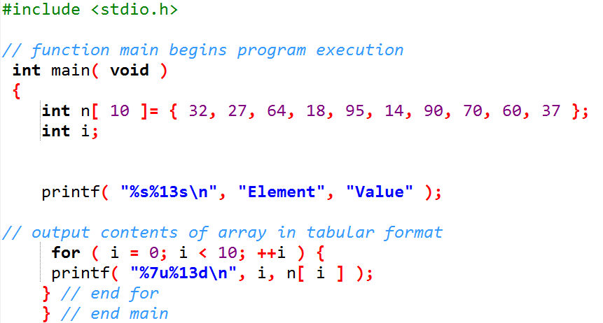
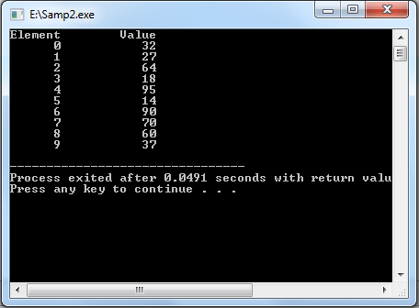
Arrays (Cont’d)

Slide 7
Arrays (Cont’d)
Characters Array or Strings
A string constant is a one-dimensional array of characters terminated by a null (‘\0’).
The terminator define end of string.
For example,
char name[5] = { ‘F’, ‘A’, ‘S’, ‘T’, ‘\0’ };
Input function scanf() can be used with %s format specifier to read a string input from the terminal. But there is one problem with scanf() function, it terminates its input on the first white space it encounters. Therefore if you try to read an input string "Hello World" using scanf() function, it will only read Hello and terminate after encountering white spaces.

Slide 8
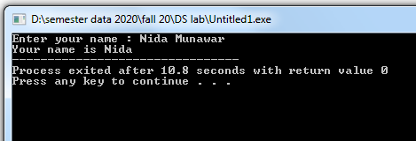
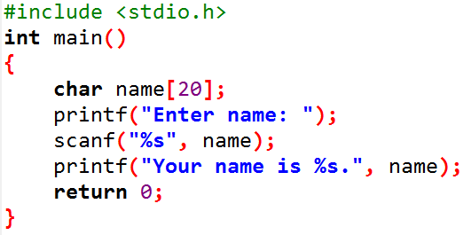
Arrays (Cont’d)
Characters Array or Strings

Slide 9
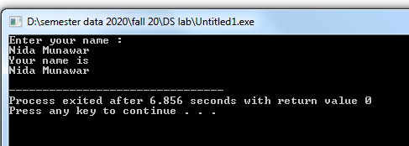
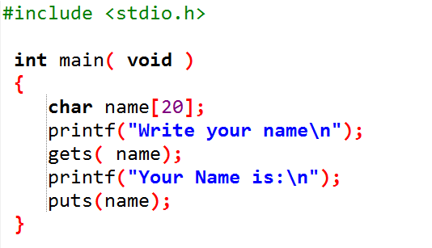
Arrays (Cont’d)
The String I/O Function gets() & puts()
Sanf() and printf() is not versatile for string I/O we can use gets() and puts() function from stdio library.
For Example:

Slide 10
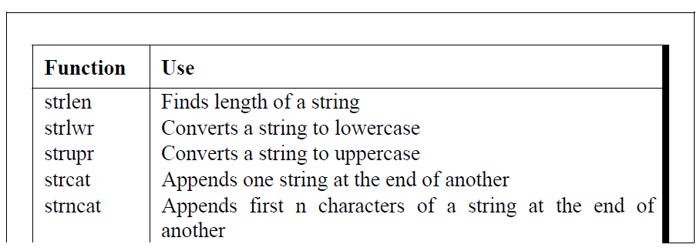
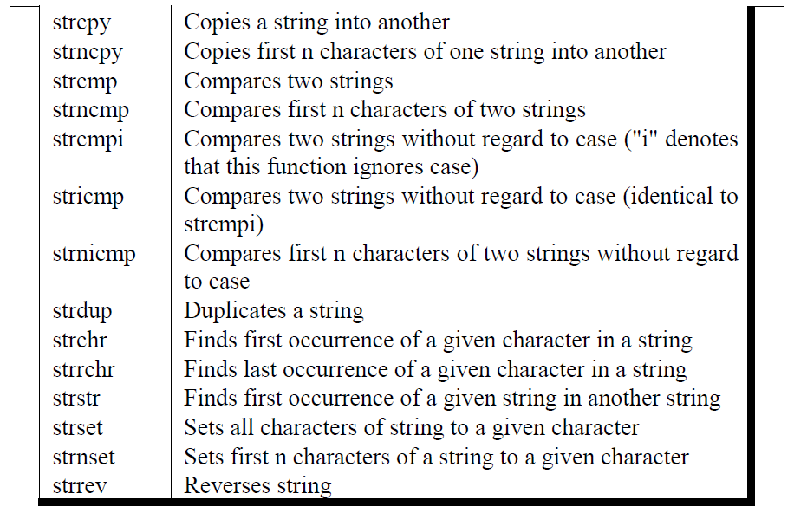
Standard Library String Functions

Slide 11
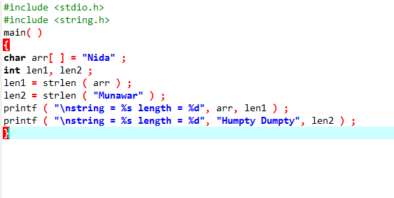
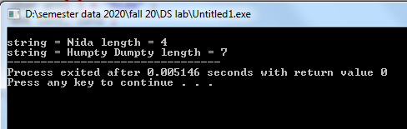
strlen( )
Note that in the first call to the function strlen( ), we are passing
the base address of the string, and the function in turn returns the
length of the string. While calculating the length it doesn’t count
‘\0’. Even in the second call,

Slide 12
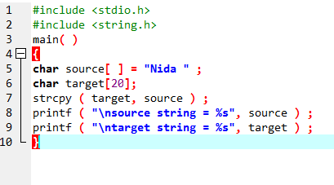
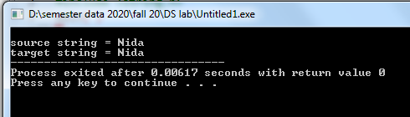
strcpy( )
This function copies the contents of one string into another.
On supplying the base addresses, strcpy( ) goes on copying the
characters in source string into the target string till it doesn't
encounter the end of source string (‘\0’). It is our responsibility to
see to it that the target string’s dimension is big enough to hold the
string being copied into it.

Slide 13
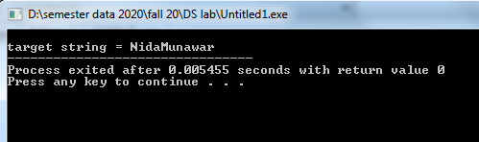
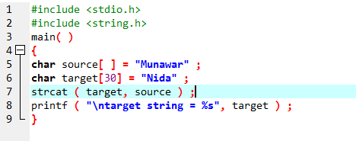
strcat( )
This function concatenates the source string at the end of the target string. Note that the target string has been made big enough to hold the
final string.

Slide 14
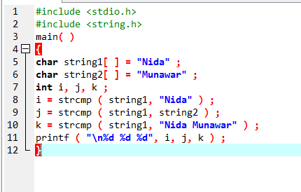
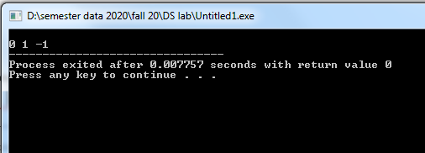
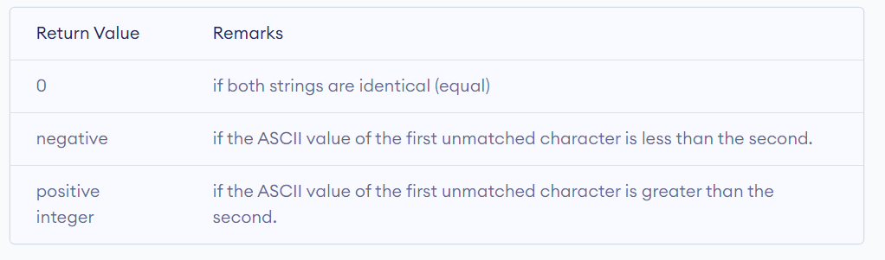
strcmp( )

Slide 15
Preprocessor Directives
The C preprocessor executes before a program is compiled.
Normal program statements are instructions to the microprocessor; preprocessor directives are instructions to the compiler.
The preprocessor more or less provides its own language which can be a very powerful tool to the programmer. Recall that all preprocessor directives or commands begin with a #.

Slide 16
Preprocessor Directives
Use of the preprocessor is advantageous since it makes:
programs easier to develop,
easier to read,
easier to modify
C code more transportable between different machine architectures.
Here we’ll examine two of the most common preprocessor directives, #define and #include.

Slide 17
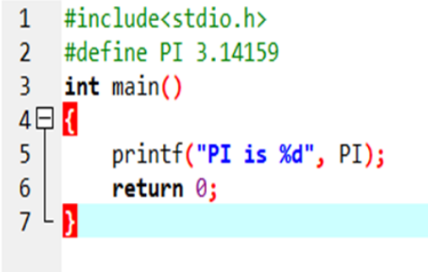
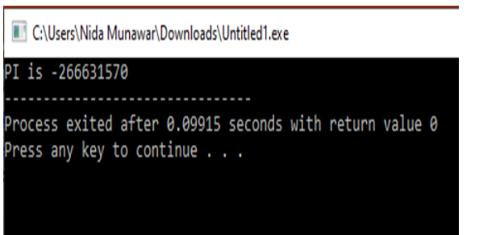
The #define Directive(Symbolic Constant)

Slide 18
Case Study: Computing Mean, Median and Mode Using Arrays
Mean – average
Median – number in middle of sorted list
1, 2, 3, 4, 5
3 is the median
Mode – number that occurs most often
1, 1, 1, 2, 3, 3, 4, 5
1 is the mode

Slide 19
Sorting Arrays
Sorting data
Important computing application
Virtually every organization must sort some data
Bubble sort (sinking sort)
Several passes through the array
Successive pairs of elements are compared
If increasing order (or identical ), no change
If decreasing order, elements exchanged
Repeat
Example:
original: 3 4 2 6 7
pass 1: 3 2 4 6 7
pass 2: 2 3 4 6 7
Small elements "bubble" to the top

Slide 20
Searching Arrays: Linear Searching
Search an array for a key value
Linear search
Simple
Compare each element of array with key value
Useful for small and unsorted arrays

Slide 21
Searching Arrays:Binary Searching
Binary search
For sorted arrays
Compares middle element with key
If equal, match found
If key < middle, looks in first half of array
If key > middle, looks in last half
Repeat
Very fast; at most n steps, where 2^{n} > number of elements
30 element array takes at most 5 steps
2⁵ > 30 so at most 5 steps

Slide 22
TASK to understand
Linear Search in array
Binary Search in array
Ascending elements
Descending elements
Bubble sort in array
Minimum element in array
Maximum element in array

Slide 23
Using Arrays to Summarize Survey Results
Forty students were asked to rate the quality of the food in the student cafeteria on a scale of 1 to 10 (1 means awful and 10 means excellent). Place the 40 responses in an integer array and summarize the results of the poll.

Slide 24
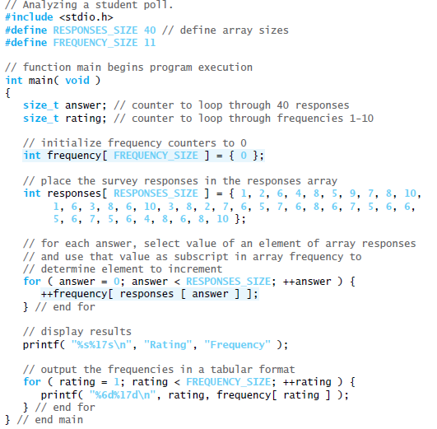
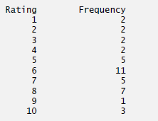
Using Arrays to Summarize Survey Results

Slide 25
Passing array to function :
Array can be passed to function by two ways :
Pass Array element by element
Pass Entire array

Slide 26
Passing array to function :
1. Pass Array element by element
Here individual elements are passed to function as argument.
Duplicate carbon copy of Original variable is passed to function .
So any changes made inside function does not affects the original value.
Function doesn’t get complete access to the original array element.
Function passing method is “Pass by Value“

Slide 27
Passing array to function :
1. Pass Array element by element
main( )
{
int i ;
int marks[ ] = { 55, 65, 75, 56, 78, 78, 90 } ;
for ( i = 0 ; i <= 6 ; i++ )
display ( marks[i] ) ;
}
display ( int m )
{
printf ( "%d ", m ) ;
}

Slide 28
Passing array to function :
2 . Pass Entire array
Here entire array can be passed as a argument to function .
Function gets complete access to the original array .
While passing entire array Address of first element is passed to function , any changes made inside function , directly affects the Original value .
Function Passing method : “Pass by Address“

Slide 29
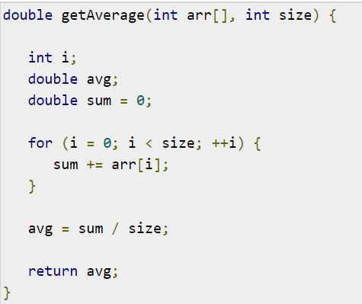
Passing array to function :
2 . Pass Entire array
Now, consider the following function, which takes an array as an argument along with another argument and based on the passed arguments, it returns the average of the numbers passed through the array as follows −

Slide 30
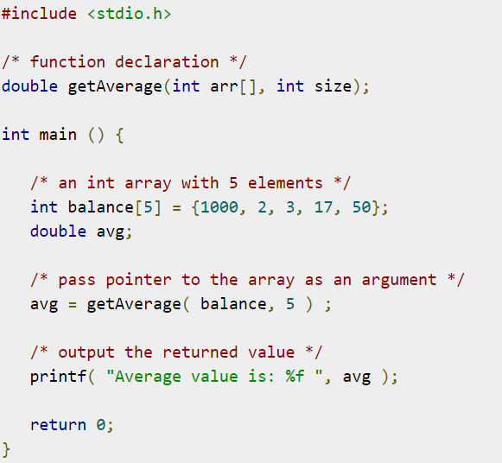
Passing array to function :
2. Pass Entire array
Now, let us call the above function as follows −

Slide 31
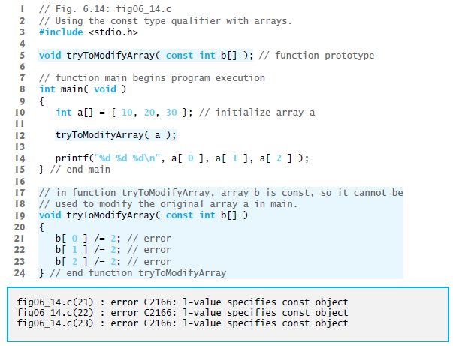

Const Qualifier:
The const type qualifier can be applied to an array parameter in a function definition to prevent the original array from being modified in the function body.

